Slide 1
Valmet’s Pyrolyzer for biochemicals
S&OP 2026
Carl Mikael Stål

Slide 2
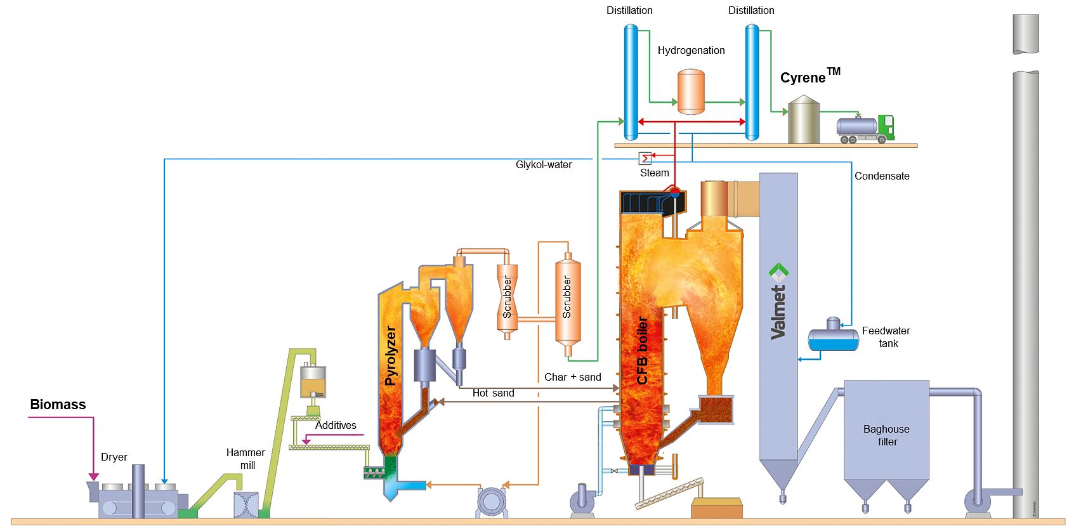
Pyrolyzer for biochemicals
Target: to produce high amounts of a biochemical
  Circa projects: levoglucosenone (LGO) from woody biomass, which is refined to a commercial bio-solvent, CyreneTM
Technology: fast pyrolysis integrated to CFB boiler
Development status
  Several pilot tests done in small-scale
  test equipment
  The first industrial scale plant
  (ReSolute) contract signed
  in November 2022
  Plant start-up in 2024

Slide 3
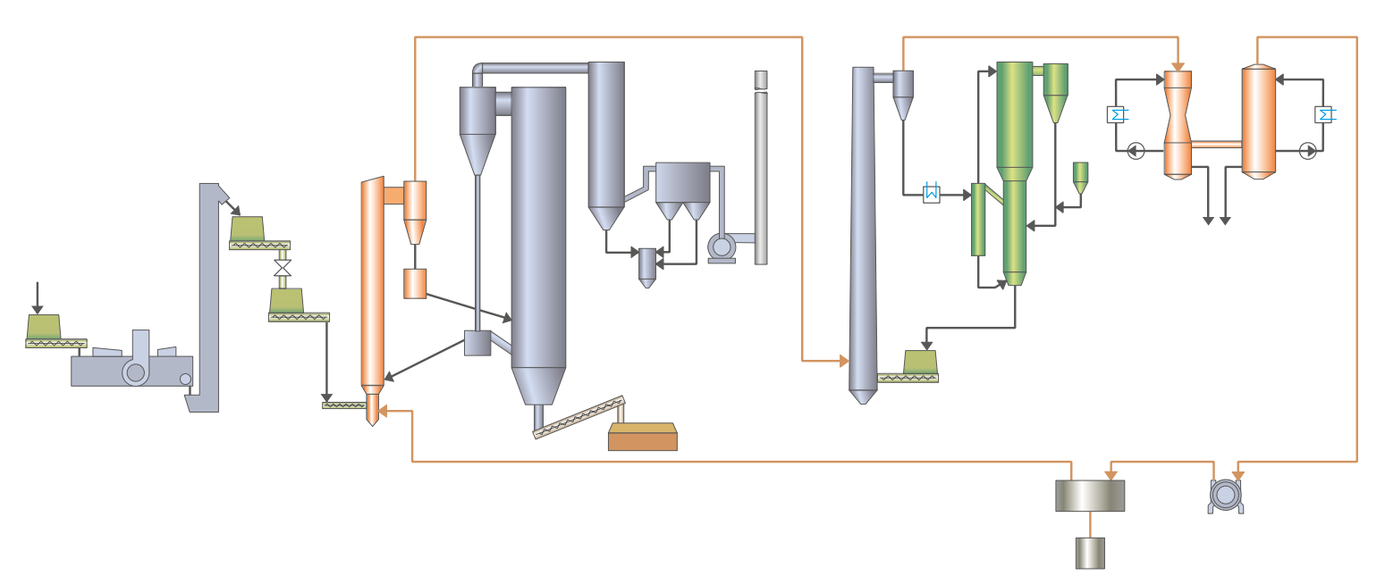
Biomass to traffic fuels – pyrolysis with catalytic upgrading
Target: to produce renewable feedstock (biocrude) to refineries and petrochemical industry from sustainable biomass sources
Technology:
dual reactor Valmet Pyrolyzer system
  First stage: Fast pyrolysis
  Second stage: Catalytic upgrading
  with catalyst regeneration
Condensing
Biocrude
Regenerator
Catalyst
Biomass drying
and crushing
Gas recycling

Slide 4
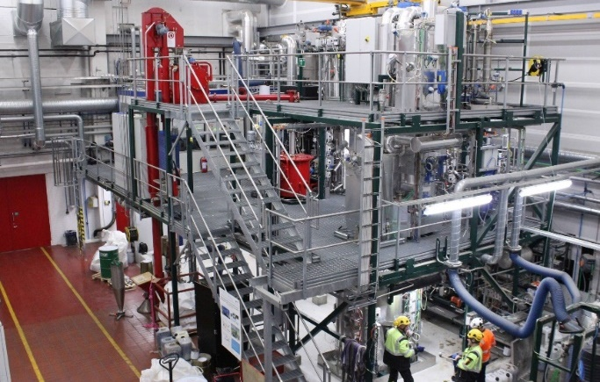
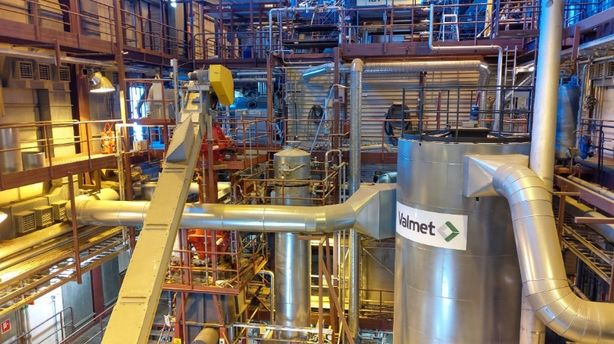
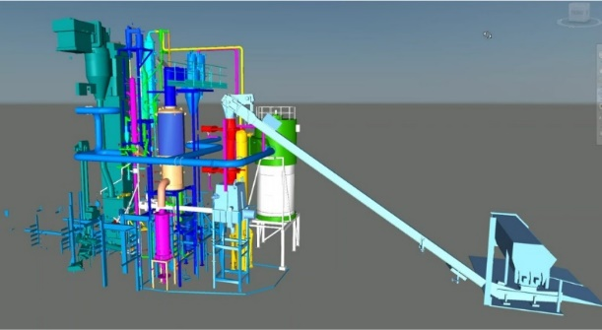
Pyrolysis to traffic fuels development
The first fast pyrolysis pilot tests were done 2011
in Valmet Energy R&D Center
Development continued focusing on catalytic upgrade
of pyrolysis vapors in order to produce biocrude
for refineries
  Pilot testing 2018...22 in VTT 20 kg/h scale
Valmet is up-grading pilot plant by adding catalytic part
  Construction work 2022–23
  Testing starts in 400 kg/h pilot plant in spring 2023
  at Valmet Energy R&D Center
Demo scale development follows
successful piloting
VTT Bioruukki, Espoo
Valmet Energy R&D Center, Tampere

Slide 5
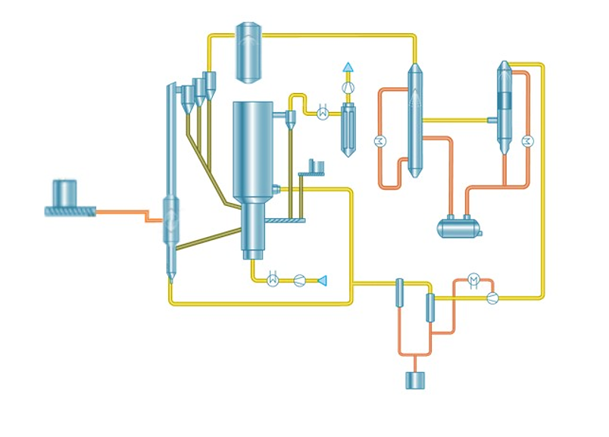
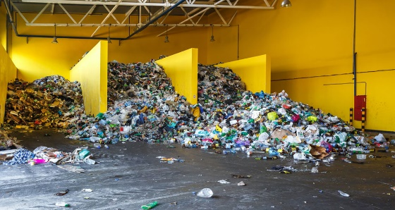
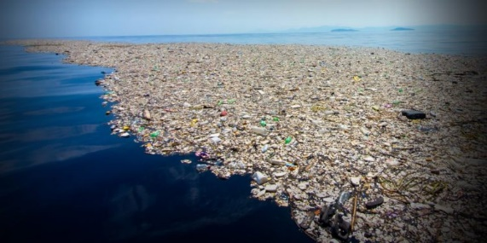
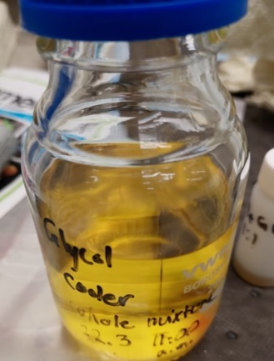
Plastics chemical recycling – plastic pyrolysis
Target: to produce pyrolysis oil from mixed plastic waste to be further processed in oil refineries/petrochemical plants to produce chemically recycled plastic.
Technology: pyrolysis with or without catalytic upgrade and business partners up and down stream of the value chain.
Development status:
  The first 20 kg/h pilot tests done – the first samples of plastic oil produced
  Industrial scale piloting under preparation

Slide 6
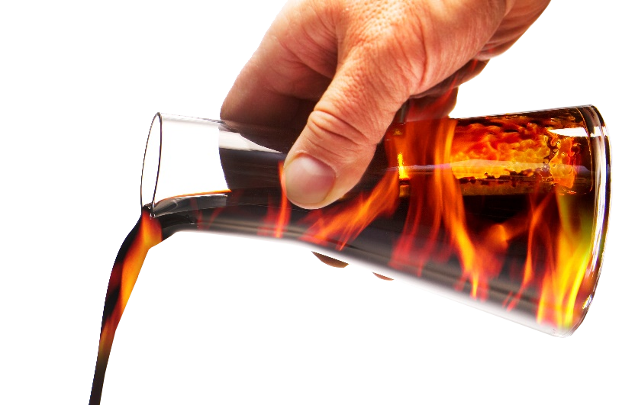
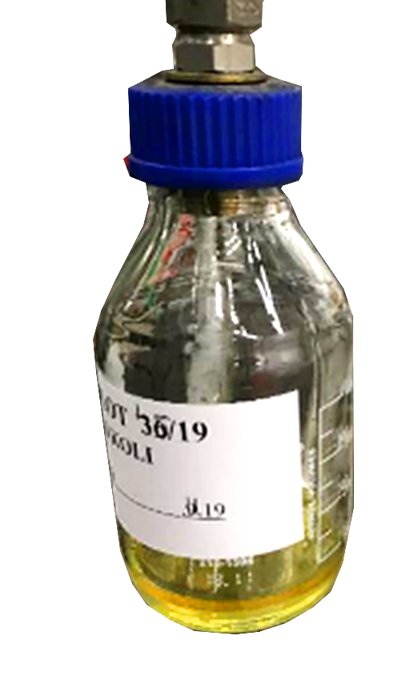
Summary
Good quality biomass shall be used to more valuable products than heat and electricity
Valmet has developed technologies to produce biocrude and bioethanol
Valmet BioTrac is a key part of the process in bioethanol production
Valmet Pyrolyzer is developed for three streams
  Biomass to chemicals by fast pyrolysis
  Biomass to traffic fuel by biomass catalytic pyrolysis
  Plastic chemical recycling by fast pyrolysis
Biomass to chemicals will be implemented in commercial scale
in Circa’s ReSolute project
Biomass to traffic fuels and plastic chemical recycling are
at piloting phase

